Slide 1

Student Ambassador Projects
Ambassador Projects Deck
Notes:
Korrie

Slide 2
Inclusi-AI Vitality Solution Type: Prototype
Deepthi Balasubramanian
Shyam Sundhar
Emmanuel Allan M J
Aviral Srivastava
Notes:
Korrie

Slide 3
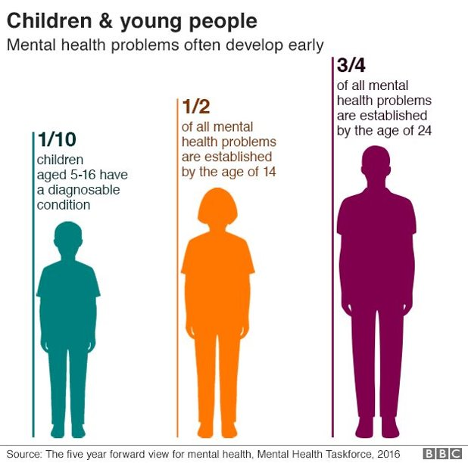
The Opportunity
Industry Trends:
In a rapidly evolving mental health landscape, the demand for accessible, personalized support is surging across demographics, defining the mental health tech industry as a pivotal force in shaping the future of well-being.
We recognize the urgency to infuse empathy into technology, understanding that traditional approaches fall short in providing the timely and tailored support individuals seek.
Challenging the Status Quo:
As disruptors, we offer big companies a fresh perspective and nimble innovation, challenging the notion that mental health support should adhere to conventional norms.
By addressing both known and unseen problems, we optimize time to value, positioning ourselves as partners in progress dedicated to reshaping the mental health narrative.
Notes:
Korrie
updated 7/21

Slide 4
Solution
We built our solution to address the critical need for compassionate mental health support, driven by a genuine commitment to alleviate individual struggles.
By providing a secure space, we tackle accessibility issues and combat the stigma around seeking help, exemplified through impactful stories.
Eg: Tina, a professional finding tailored coping mechanisms through our empathetic chatbot.
In the digital wellness and mental health support realm, we go beyond categorization. Our focus on infusing technology with empathy sets us apart, offering a transformative approach that competitors, despite their stature, often lack. With unwavering commitment to user confidentiality and cutting-edge AI capabilities, we bring a personalized, supportive, and transformative touch to mental well-being.
Notes:
Korrie
updated 7/21

Slide 5
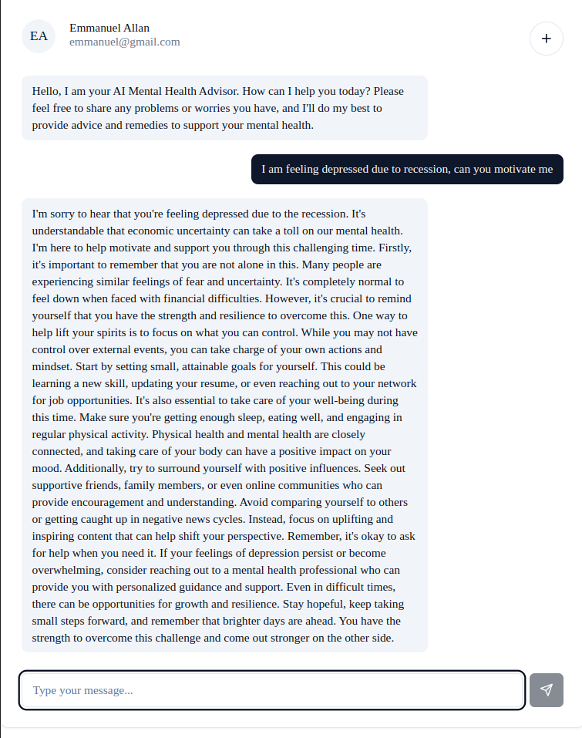
Demo
Our innovative AI based Mental Health Support Chatbot is designed to provide a confidential and empathetic space for individuals experiencing stress, depression, or simply seeking a supportive friend. Acting as a virtual psychologist and mental health advisor, this chatbot is dedicated to offering guidance and assistance to users in their mental well-being journey.
Demo Link: Inclusi-AI Vitality Demo Video.mp4
Notes:
Korrie
updated 7/21

Slide 6
Technologies Used
Deployment: Azure App Services
AI tool: OpenAI service
Storage: Azure Storage Account
Queries and data handling: Azure Postgres Flexible Service
Application Frontend: NextJS
Application Backend: Flask

Slide 7
Takeaways
Recommendation:
Pause reliance on traditional models, embrace technology-driven mental health solutions for agility and effectiveness.
Independence:
Encourage open communication and support for mental well-being within organizations; destigmatize seeking help.
Enhancing Processes:
Our solution expedites mental health support, providing immediate, confidential assistance, making the process efficient and widely accessible.
Notes:
Korrie
updated 7/21

